Slide 1
Strengthening the protection of human rights of older persons in
Long-term and palliative care
Rio Hada
Office of the United Nations High Commissioner for Human Rights (OHCHR), Geneva

Slide 2
2030 Agenda and the SDGs: A paradigm SHIFT
Strongly grounded in all human rights
Promise of “Leave no one behind”
  People-centered focus
  Equality and non-discrimination
Call for rights-based implementation
Empowerment of older persons
Many SDGs (health, work, equality etc) are relevant to LTC

Slide 3
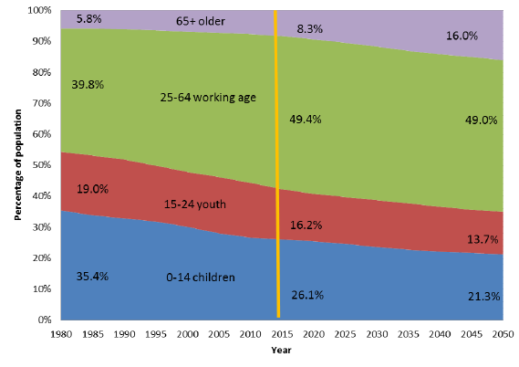
Demographic SHIFT
Percentage distribution of global population by broad age group, 1980-2050

Slide 4
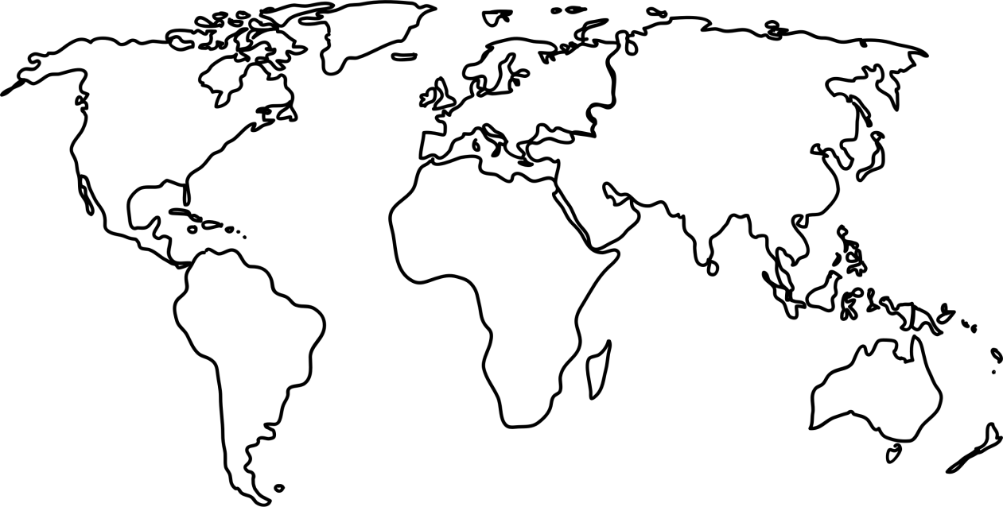
Demographic SHIFT
Population Projections: Aged 60 years and over, 2017 vs 2050
Northern America
2017: 22%
2050: 28%
Europe
2017: 25%
2050: 35%
Asia
2017: 12%
2050: 24%
Latin America and the Caribbean
2017: 12%
2050: 25%
Oceania
2017: 17%
2050: 23%
Africa
2017: 5%
2050: 9%

Slide 5
Social and cultural SHIFT
From negative perception of older persons …
  Seen as less valuable to society
  Dependent on younger generation
  Burden on the economy
  Weak and frail
  Their judgement and decision making should be deferred to others to ‘protect’ them
... to older persons as “rights-holders”
  Active agent in society
  Skills, knowledge and experience

Slide 6
Long-term care and palliative care
Integral part of the right to social security, including social insurance, and the right to health (UDHR art. 25(1), ICESCR arts 9 and 12)
Aims at maintaining or regaining the optimum level of physical, mental and emotional wellbeing and to prevent or delay the onset of disease (IE)
Needs an integrated approach, combining elements of preventive, curative and rehabilitative health treatment (CESCR General Comments 6 and 14)
Part of the social protection floor, guaranteeing access to essential health care and basic income security for older persons (ILO Recomm 202)

Slide 7
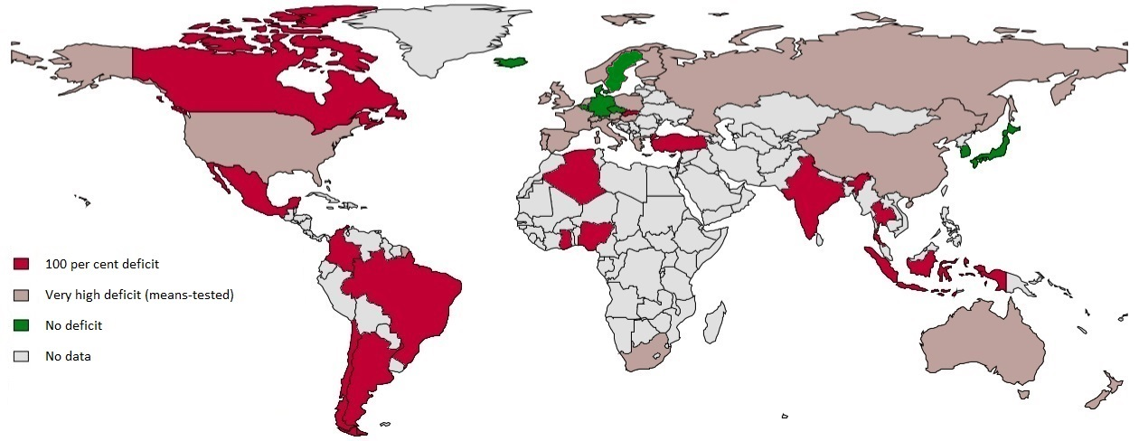
Global deficits in LTC coverage
Global deficits in LTC coverage for older persons aged 65+
in % of total population, 2015
Percentage of global population 65+ excluded from LTC coverage
Source: ILO estimates 2015, World Bank, 2015 (population data in 2013)
48% ( 300 million people) of the global older population lives in countries without any right to LTC
46.3 % of the global population lives in countries with means tests forcing people to become poor
before becoming eligible for LTC
Only 5.6% of the global population aged 65+ lives in countries with rights-based universal LTC coverage

Slide 8
Global shortage of LTC workforce
*Threshold: 4. 2 per 100 persons aged 65+
Source: ILO estimates, 2015; OECD, 2014

Slide 9
Composition of the LTC workforce
High-income countries / Europe:
  Family members are providing up to 90 % of care. Their numbers exceed by far that of formal workers
Low and middle-income countries:
  Numbers of family carers are estimated to be even higher than in European countries due to the nearly complete absence of formal LTC workers and LTC infrastructure

Slide 10
Human rights concerns in LTC
Ageism and age discrimination
Disproportionate impact on women
Violence, abuse and neglect
Use of restrictive interventions and practices

Slide 11
Palliative care: fundamental to dignity and HR
An approach that improves the quality of life of patients and their families facing the problem associated with life-threatening illness, through the prevention and relief of suffering by means of early identification and impeccable assessment and treatment of pain and other problems, physical, psychosocial, and spiritual (WHO)
Attention and care for chronically and terminally ill persons should be provided, sparing them avoidable pain and enabling them to die with dignity (CESCR General Comment 14)

Slide 12
SHIFT to human rights-based approach
Comprehensive approach to LTC that integrates palliative care
Recognition of ageing as human rights issue
Putting older persons at the centre
Remove age-based discrimination in laws, policies and practices
Prioritize public expenditures to strengthen formal care
Data availability and disaggregation
Strengthen the role of NHRIs and civil society

